Slide 1
Making your APP
Lesson 5/6
You finally get to make your APP!

Slide 2
WALT and WILF
WALT – Produce our APP’s with our designs in mind (always remember your audience and purpose)
WILF –
A completed APP that matches your designs
It should be produced with audience and purpose in mind
It should include features that you have learnt how to use in APPShed

Slide 3
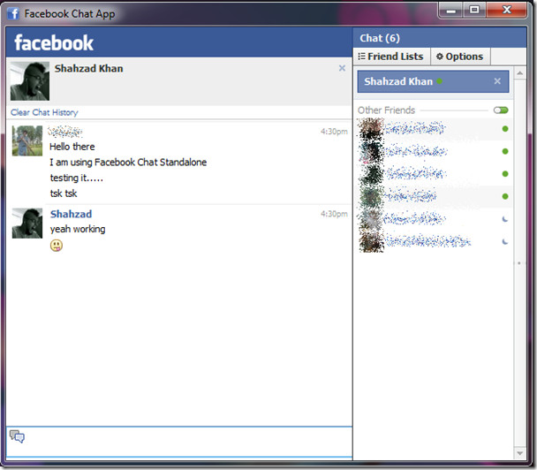
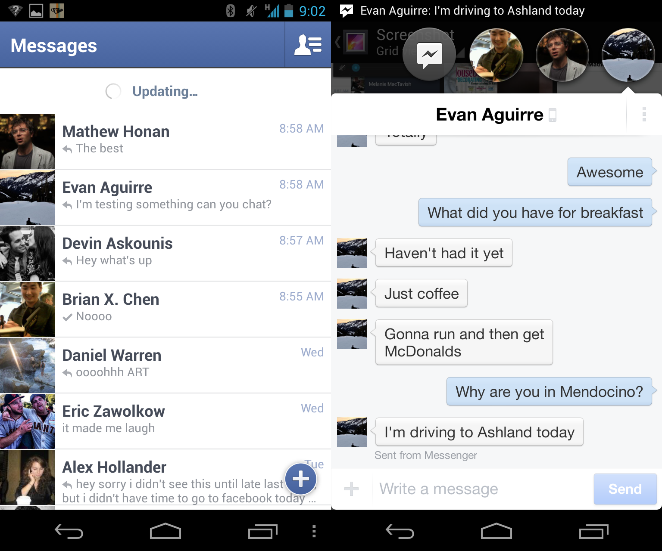
Which is better?
Facebook Old Chat
Facebook Messenger

Slide 4

Making your APP
You now have to design your APP. Follow your designs and use the images that you have gathered!
In the future your peers will look through your APP and assess how successful they believe it to be.
REMEMBER: Audience, Purpose and Category!

Slide 5

Peer Assessing
Using the feedback forms on the website:
Review the persons APP that you are looking at. Remember to look at how clear the following are:
Is it clear who the audience is?
Is it clear what the purpose is?
What has worked well/not so well?
Sheet needed – Peer Assessment Feedback

Slide 6

Improving your APP
You have some time to improve your APP – read what others have said and try to improve your APP based on what has been suggested.
Once you have completed this fill in the SCREENSHOT document on the Website
Sheet needed – Screenshot Evidence of My App

